Slide 1

Credit risk classification
“German” dataset by Dr. Hans Hofmann University of Hamburg.
Fiona Dick
Bergen, 25.08.23

Slide 2
My notes
Notes:
outlier detection scatter plots
parallel category plot to relate categorical variables to each other
-brier score to check if predicted propabilities match actual probabilties
-feature importance to interpretation
e.g information gain xgboost |
30% bad cases-> if are the positives (1) then FN are very important that would be missed bad risks
if good are the positives then FP are very important..that encoding is more intuitive -> ROC AUC but maybe better PR AUC for both classes and F1 score hamonic average--> detection of rare events but they dont generalize well
does no checking or saving account most likley mean no savings or is it a true NA
-standard scale numerical variables (robust to outliers)
-age categories?!
-split personal status and gender?
-number of existing credits is ordinal
-which other variables are oridnal?
people liable
-imbalanced predictors:
foreign workers
guarantors
other installment plans
job unemployed category
number of existing credits category 4
personal status
checking account
--> could reduce number of categories for these
-simple feature selection: chi square
-pca?
-balance dataset:
by definition mild imbalance (within 40% minority cases)
balance train:
1. train on true distribution -> if it generalizes well good
2. downsample balance training data--> reduce number of bad risk instances
stratified sampling versus random sampling
Accuracy bad metric for imbalanced dataset
area under ROC
so try to model without resampling but look at precision and recall and if at accuracy then compare to baseline
SMOTE in python synthesizes minority class samples
-zeroR or randomRate
Odds of Guessing Minority Correct: 0.25 * 0.25 = 0.0625
Odds of Guessing Majority Correct: 0.75 * 0.75 = 0.5625
Baseline = 0.25**2 + 0.75**2 = 0.625
-> informs how much value model adds to random guess but accuracy must additionally be over majority vote guess (zeroR)
-test 25%
-caret createDataPartition, DMwR -> smote function
trainIndex <- createDataPartition(iris$Species, p = .8, list = FALSE)
training <- iris[trainIndex, ]
testing <- iris[-trainIndex, ]
# Apply SMOTE to the training set
training_balanced <- SMOTE(Species ~ ., training, k = 5, perc.over = 100, perc.under = 200)
# Train a decision tree model on the resampled training set
model <- train(Species ~ ., training_balanced, method = "rpart")
# Evaluate the performance of the trained model on the testing set
predictions <- predict(model, testing)
confusionMatrix(predictions, testing$Species)
-feature selection

Slide 3
Main objectives
Classification: Predict "bad risk" class
Aim for high accuracy
BUT: Identification of bad risk is more important
Evaluation: Test performance of final model
Variable importance: Interpretation of the model, what can the predictors tell us about risk

Slide 4
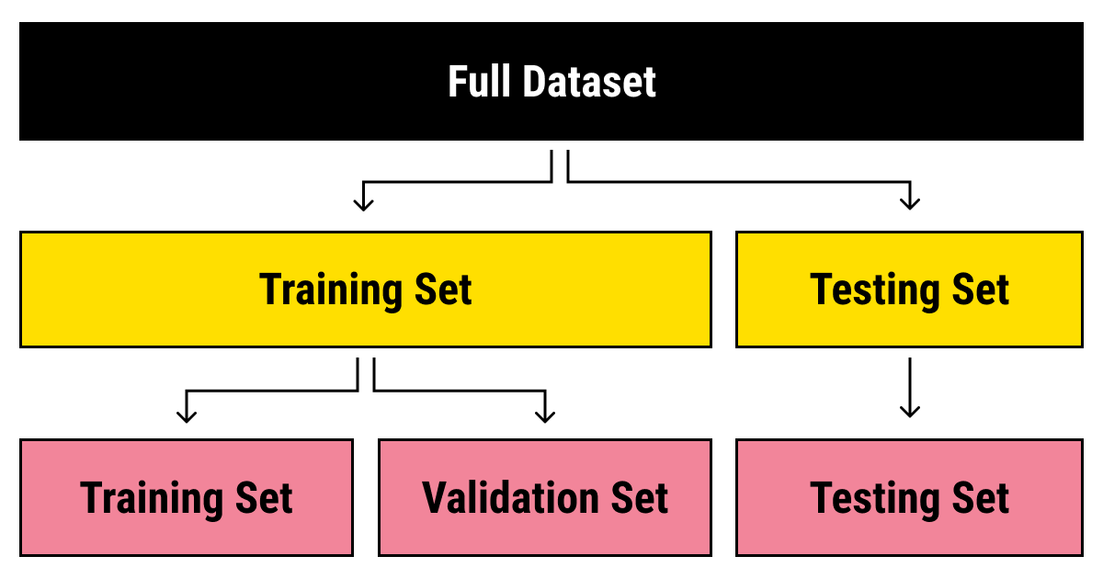
Workflow
Limited exploratory analysis
!!Caution: Data leak danger !!
Distribution of predictors, interactions or correlations between them
Underrepresented levels in categorical variables
Identification of outliers
Associations with response variable
Gain already valuable insight through data patterns
2. Data split
Consider: Random sampling?
Is order of data points relevant?
Imbalanced response variable?
Perserve proportions in both train and test (stratified split)
Or up/down sample minority/majority class
3. Feature engineering
Should generally be done after split to avoid data leakage
Dummy (necessary when model can't handle collinearity) or oneHot encoder
Standardization and/or transformation of numerical variables
Encoding of ordinal categorical variables
Feature reduction/selection: p >> n High dimensionality? -> Reduce feature space

Slide 5


Workflow
4. Model selection
Choice of algorithm
Hyperparameter tuning and training
Resampling
IMPORTANT: choice of evaluation metric adapted to main objective
Possibility for iterative feature selection
Determine the best model
Re-evaluate performance (feedback loop)
5. Final model evaluation
Use model to predict on held out test set
Overfit? -> Test performance much worse than train performance
Estimate certainty of prediction
6. Model interpretation
Understand the model
Draw conclusion, e.g. feature interactions, importance

Slide 6
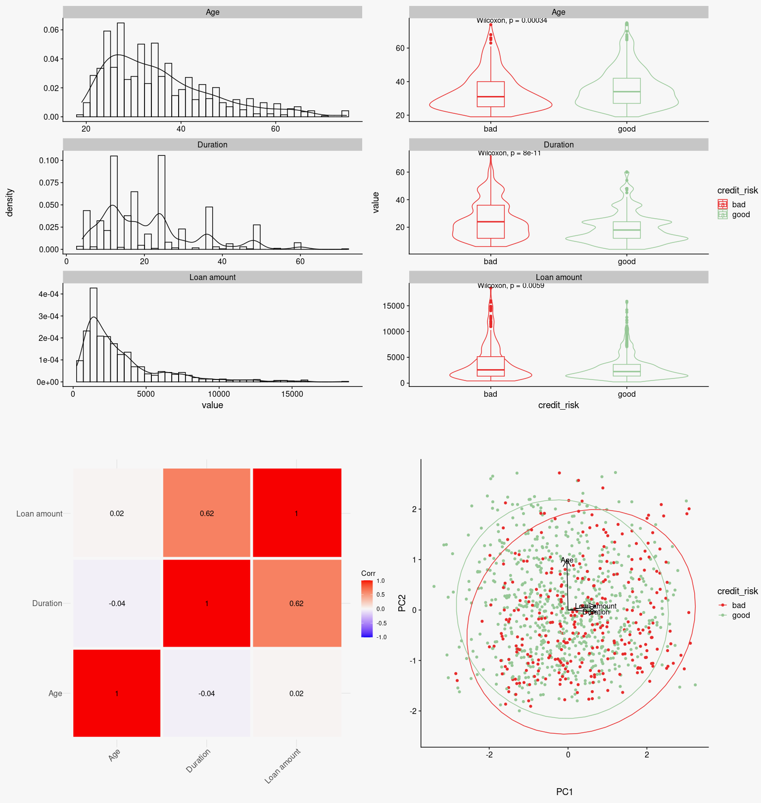
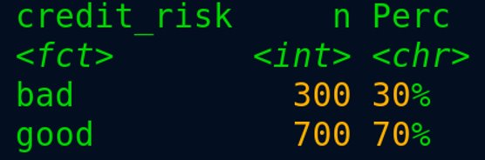

EDA Examples
No missing values
However, categorical variables with levels that don't give information
Did not do any imputation

Slide 7
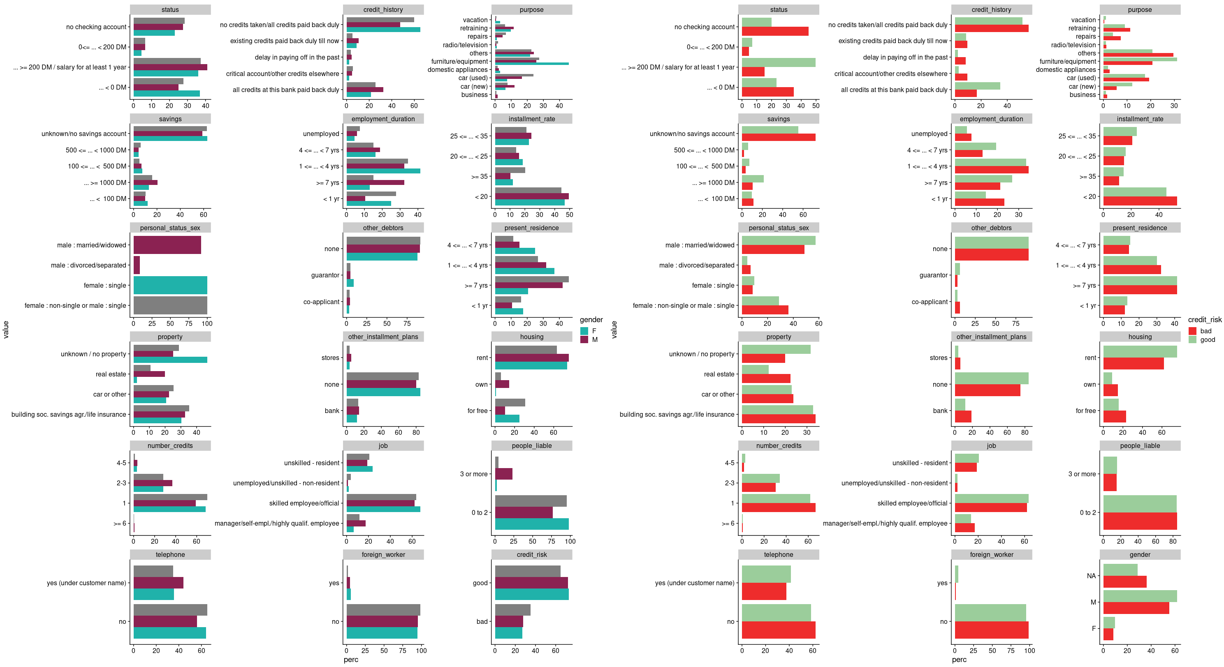





Notes:
How are the cases of bad or good risk distriubted across categories and which values are underrepresented

Slide 8
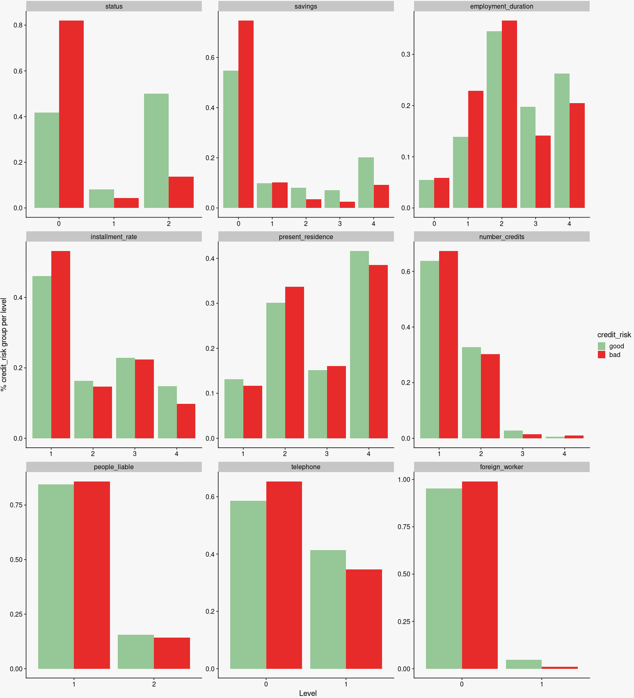

Precentage of individuals of each credit risk group distributed across values of ordinal variables

Slide 9
Dummy vs one-hot & feature engineering before/after split
-feature engineering on train only and apply function to test
-instead of log, standardize numerical variabes min, max
-if you do dummy instead of one hot one value category is dropped, if you do this processing before data split, it could cause problems when applying the same transformation on test data were maybe one of the levels is not present -> then youd end up with another variable
-dummy encoding necessary for models were collinearity is a problem (lm)

Slide 10

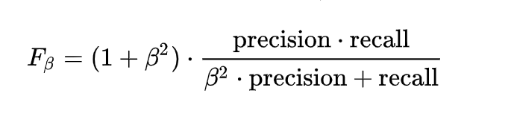
Evaluation metrics
"Positive" = "Bad"
Imbalanced classes: "Bad" is minority class
Objective: more weight on preventing FN
Accuracy could mislead: good performance or just as good as a random guess (class ratio)
Precision = TP / (TP + FP) "minimizes FP, doesn’t care about FN"
Recall = TP / (TP + FN) "minimizes FN, doesn't care about FP"
First priority: Avoid losing money to bad risk loans
Second priority: Miss out on good risk opportunities
Choice: Fbeta
summary of precision and recall with more weight on recall if beta > 1
Keep an eye on standard deviation of chosen evaluation metric (across folds)
Notes:
Probabilistic metrics (quantify the uncertainty in a prediction): Briers score (“mean squared error between the expected probabilities for the positive class (e.g. 1.0) and the predicted probabilities”) but not popular for imbalance problems -> so using when down or up-sampling -> considered using it but time was limited stuck to Fbeta

Slide 11
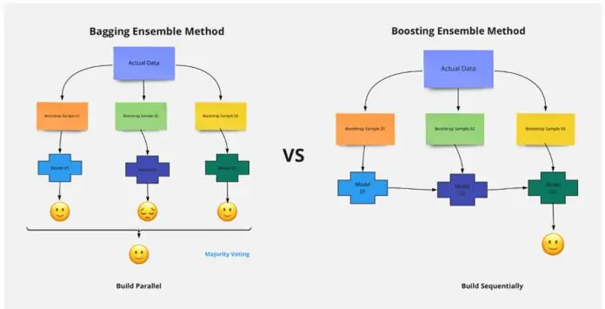
Algorithm & tuning method
Xgboost
Ensembl tree method -> improved accuracy (robust)
Non-parametric (no assumption about predictor distribution)
Can handle collinearity
Computationally efficient
Sequential: learns from previous iterations (vs random forest bagging)
Cons: interpretability, prone to overfit, difficult tuning (many hyperparameters), possibly sensitive to outliers
Training & tuning
Grid search
Cross validation
Imbalanced, down-, up- and smote sampling
Removed non important features & repeated model training
image source https://cdn.educba.com/academy/wp-content/uploads/2021/08/Random-Forest-vs-XGBoost.jpg.webp

Slide 12
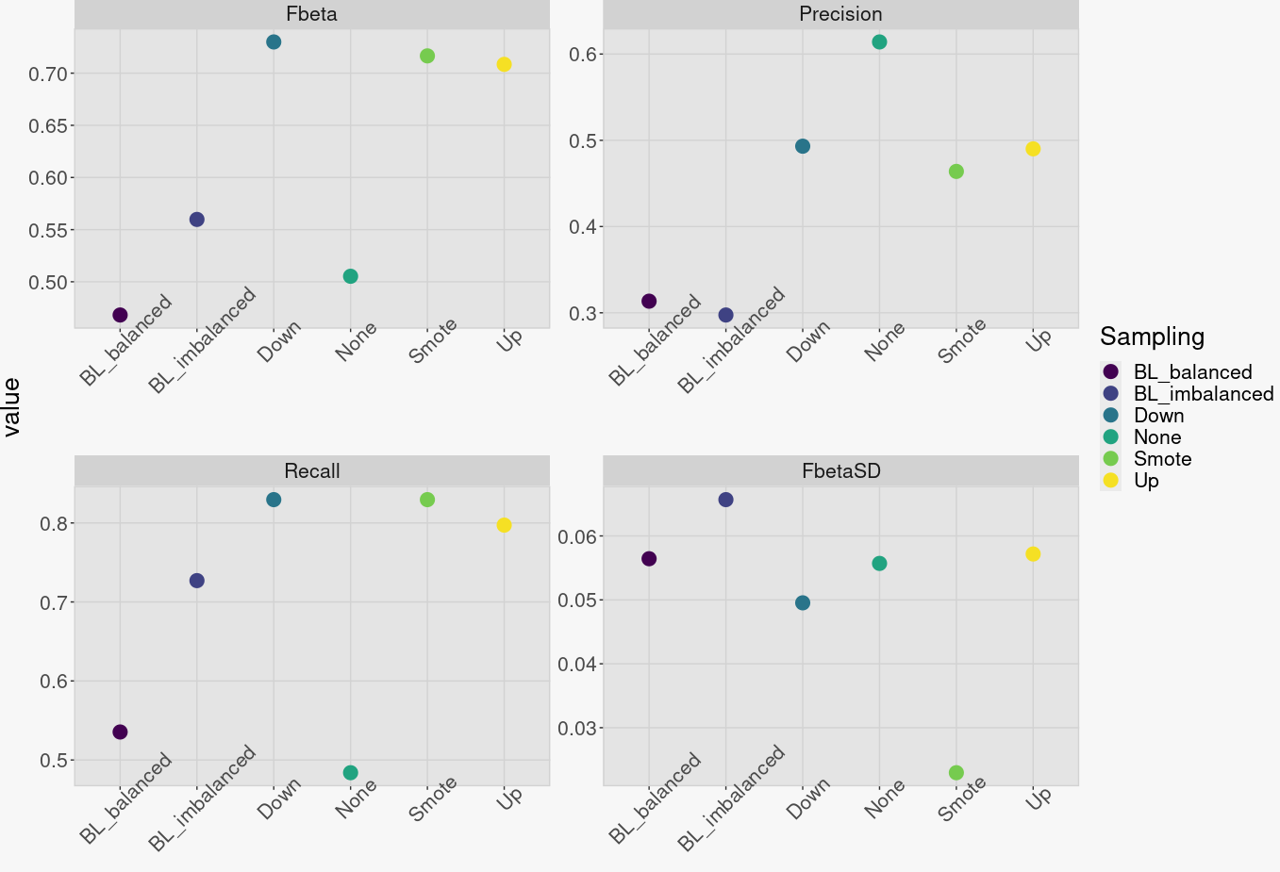
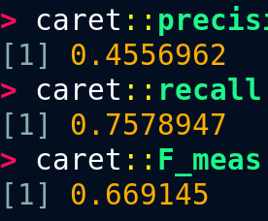
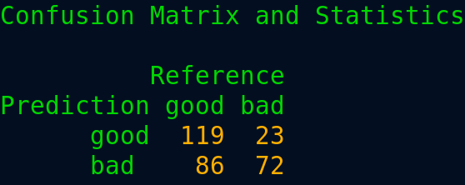
Results
Baseline model on
Imbalanced with random sampling (0.3,07)
Balanced with random sampling (0.5,0.5)
Potential winner:
Down-sampling:
Highest Fbeta
Highest recall but not lowest precision
Relatively low sd for Fbeta
Next steps (wishful thinking):
Investigated variable importance across all models
Removed variables with consistent low to zero importance in all models
Reran same training with reduced feature set
Evaluated again
Chose best model
Predicted on test set
--> didn’t make it in time :/
Down-sampled model performance on test set:

Slide 13
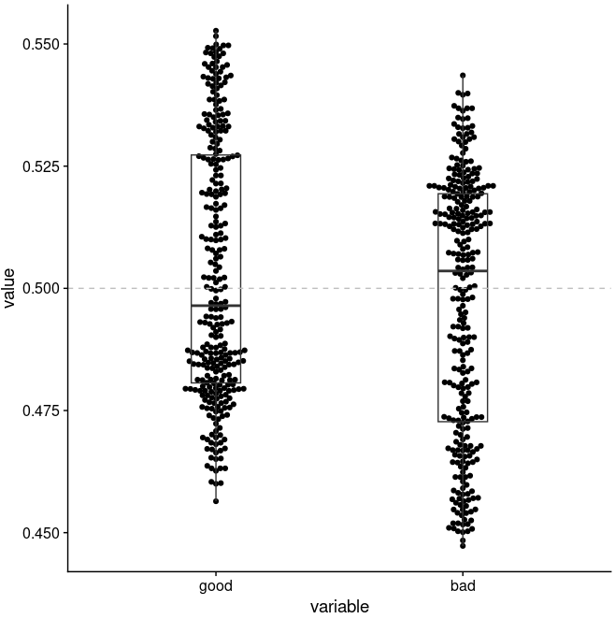
Additional model evaluation
Work with class probabilities
Estimate certainty of a prediction
Most simplest method: what is my maximum probability
With a 0.5 threshold it's "easier" to predict "good" and not to predict "bad"
Bimodal distribution around 1 and 0 would be optimal
Is 0.5 the best threshold?
--> could also tune the probability threshold

Slide 14
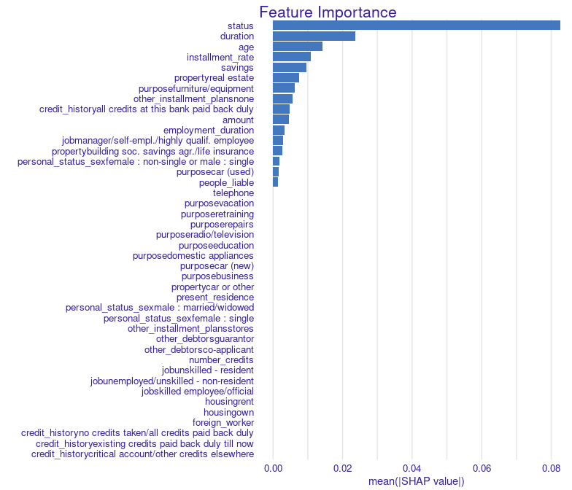
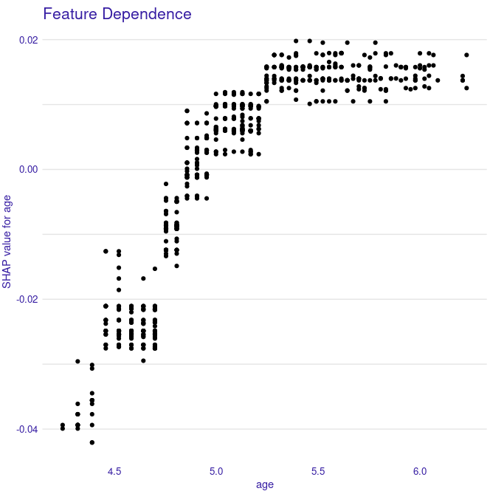
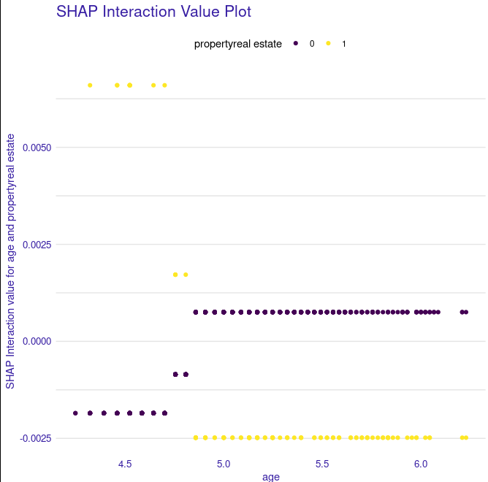
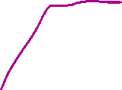
Model interpretation
Variable importance measures:
Weight: # times feature is in split
Cover: # times features is in split normalized by # data points in split
Gain: average training loss reduction gained when using feature in split
Gain bias: if deep trees -> more weight given to lower splits although features in splits closer to root might be more important
Alternative treeshap method -> averaging differences in predictions over all possible orderings of features
Notes:
TODO:
can also plot feature important for each individual in the dataset to identify outlier effects color by probability to being “bad”
are there variables that are not important in general but very important for specific subset of individuals
Can plot numerical variables correlation with importance (per individual) for example age: between 20 and 40 steep increase of importance, from 40 on wards rather constant
if there are values constant at x (age) but dispersion on y, other variables affect the importance gain
https://towardsdatascience.com/interpretable-machine-learning-with-xgboost-9ec80d148d27
Vertical pile of dots, same x value but logg loss changes, meaning at that constant age value other features contribute to the incease
Y is how much the feature changes the logg odds of being "bad"

Slide 15
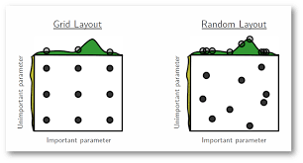
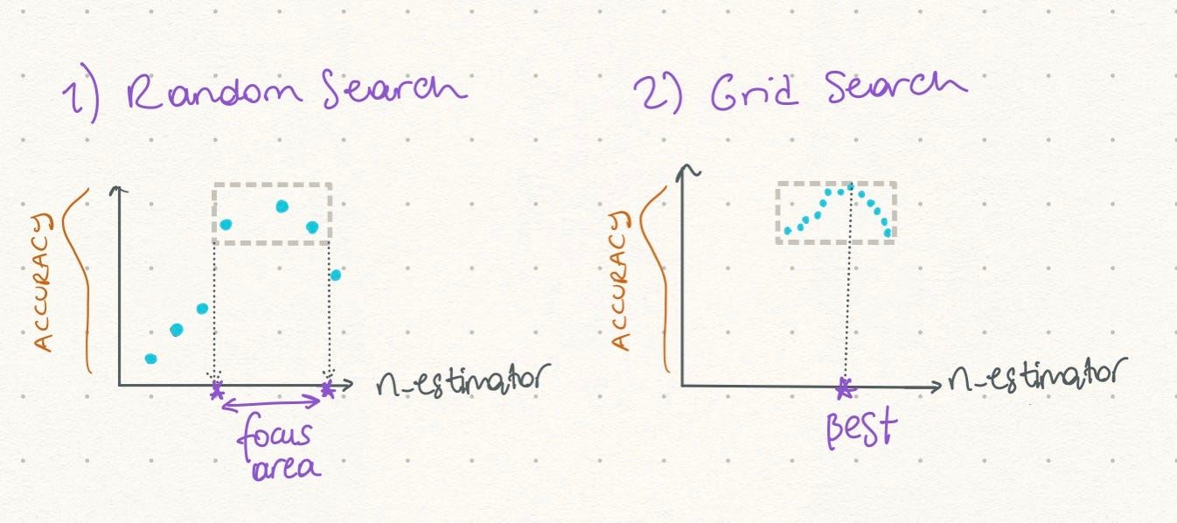
Alternatives for grid search
Grid search:
Good if familiar with parameters
Doesn't learn from previous results and tests all combinations
-> Computationally expensive
Random search:
Distribution of hyperparameters & combinations tested randomly (not all are tested)
Hybrid:
Combination of both
Start with random search to find the most promising range, set up a fine grained grid in this range and test all combinations
image source https://miro.medium.com/v2/1*ZTlQm_WRcrNqL-nLnx6GJA.png
image source https://miro.medium.com/v2/resize:fit:1400/1*OM-G422s32hcu9SyYDYtww.png
Notes:
(h even though grid search will always find the best combination if the parameter grid is selected poorly the best combination will not be performing well)

Slide 16
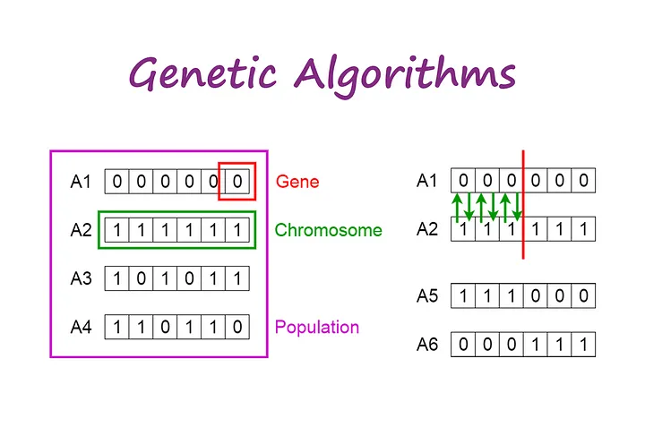
Alternatives for feature selection
Prior to modeling with dimensionality reduction for example PCA
Genetic algorithms:
START
Generate the initial population
Compute fitness
REPEAT
Selection
Crossover
Mutation
Compute fitness
UNTIL population has converged
STOP
Illustrated is a population with individuals
Selection: select the individuals with strongest fitness
Among these apply genetic operator such as cross over (illustrated right) Or mutations
-> Generated a new generation
Image source https://towardsdatascience.com/introduction-to-genetic-algorithms-including-example-code-e396e98d8bf3

Slide 17

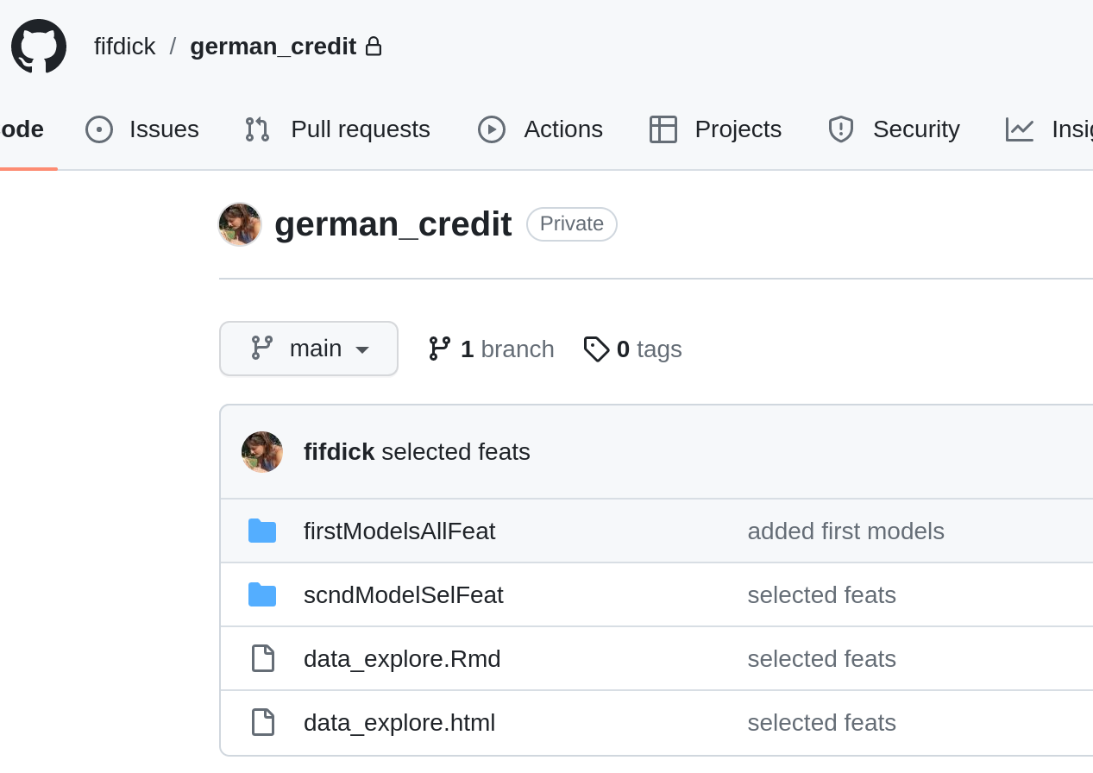
Project documentation
Code in R Markdown
Self-contained .html report
Models saved as .rds objects

Slide 18
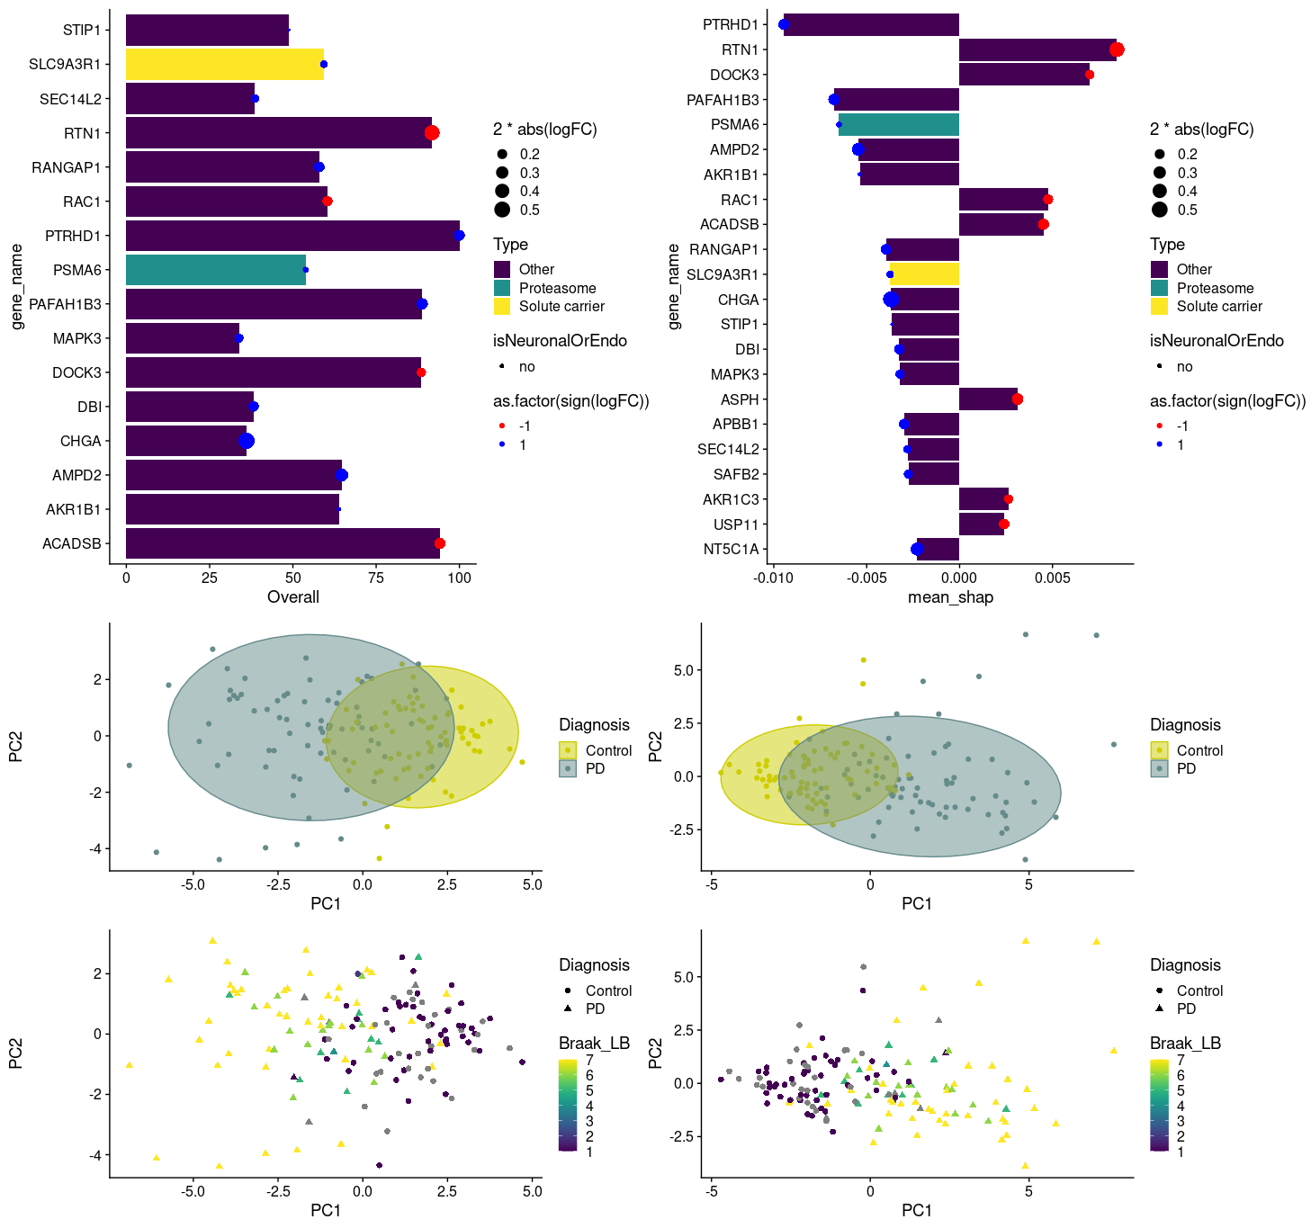
Same method applied to biomarker detection
Xgboost to classify Parkinson's patients from healthy controls
Based on protein expression data of post-mortem brain tissue
Balanced dataset
Biases: neuronal degeneration, post-mortem time, age at death
High collinearity
Highly dimensional p > n
Good performance
Identified biomarker candidates for diagnosis and disease progression

Slide 19











Slide 20
Takk for oppmerksomheten

